Slide 1
To bypass a cisco router password using CISCO Packet Tracer.
Utsav Jain(D17C - 22)
Rachana Kamat(D17C - 28)
Priya Puranik(D17C - 54)

Slide 2
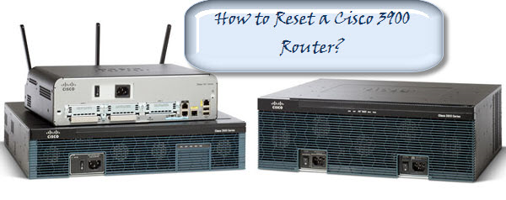
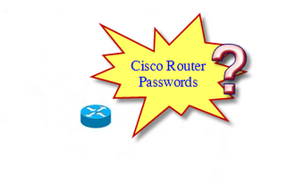
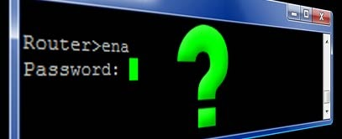

Slide 3
Introduction
Packet Tracer is a cross-platform visual simulation program designed by Cisco Systems that allows users to create network topologies and imitate modern computer networks.
The software allows users to simulate the configuration of Cisco routers and switches using a simulated command line interface.
The command line can be used for creating a router-to-pc connection.

Slide 4
Problem Statement
Using passwords and assigning privilege levels is a simple way of providing terminal access control in your network.
Cisco router password can be easily hacked if no encryption is enabled.
Cisco Packet Tracer effortlessly provides an additional layer of security, particularly for passwords that cross the network .
Cisco commands allows to establish an encrypted password that users must enter to access enable mode (the default), or any privilege level user specify.
Unauthorized individuals are prohibited from viewing your password in your configuration file.

Slide 5
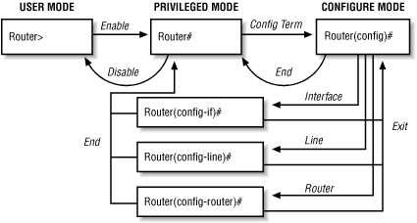
Diagrams

Slide 6
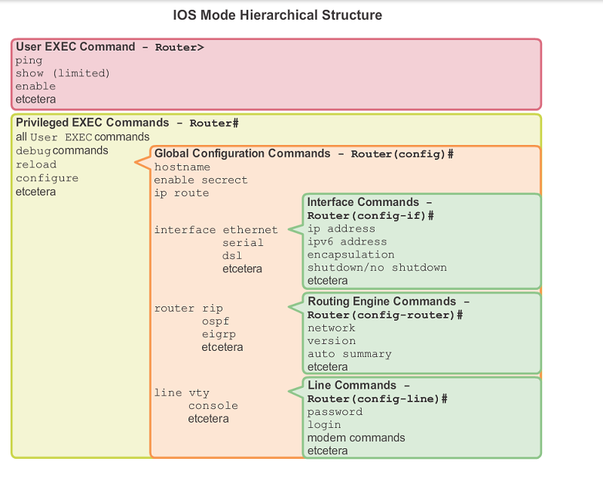

Slide 7
Proposed Work
Open Connections are always a problem and are never secure.
These open connections can be used by anyone. These connections can also be misused and provide no confidentiality or authentication.
Router passwords can also be hacked.
Encrypting the password therefore provides the security and the passwords become very difficult to hack.

Slide 8
Future Scope
Security of passwords can be used by encrypting it.
Using the latest but well tested encryption algorithms can provide more security.

Slide 9
Conclusion
The demonstration describes how to recover the enable password and the enable secret passwords.
These passwords protect access to privileged EXEC and configuration modes.
The enable password password can be recovered, but the enable secret password is encrypted and must be replaced with a new password.

